Slide 1
Detecting Signs of Depression in a Cross-Linguistic Context Using Machine Learning
Author: Dinică Mircea

Slide 2
Depression
Affecting over 300 million individuals worldwide
Disinterest in routine activities
Sleep disturbances
Inability to feel pleasure
Grim thoughts

Slide 3
Proposed prevention method
AI model that can be included in applications
Input: text
Output: is depression or not
Applicable for multiple languages

Slide 4
Model for English Language
Dataset with 7731 entries
LIWC-22 processing tool: 119 features
Random Forest Classifier
Classification Metrics, Confusion Matrix, Feature Importance

Slide 5
Dataset
7731 entries: 3900 no depression, 3831 depression
Depression: it s so pointless for me to still be alive my life is worthless why am i still here
No Depression: i hate when i have to call and wake people up

Slide 6
Linguistic Inquiry and Word Count
Categorizes words in different psychological states and grammar parts
Uses a dictionary that contains the category as key and the words as values
Translated for multiple languages
Easy to use

Slide 7
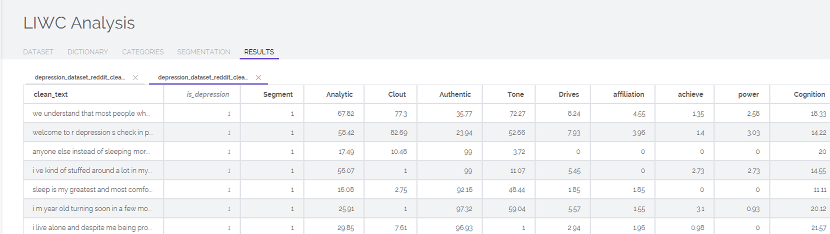
LIWC Output
Contains selected metrics and their percentage of words found

Slide 8
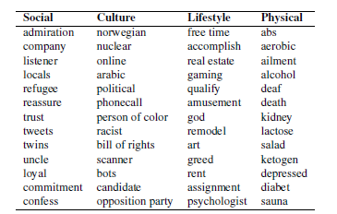
LIWC dictionary categories examples

Slide 9
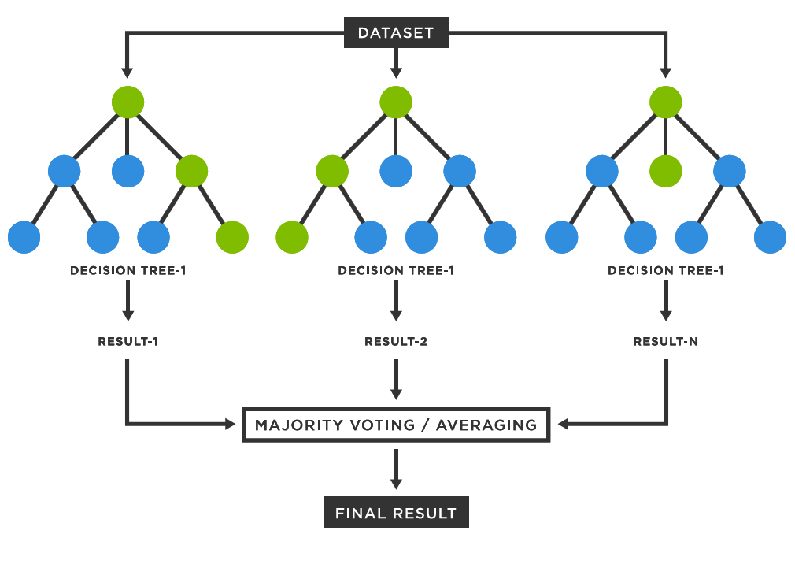
Random Forest

Slide 10
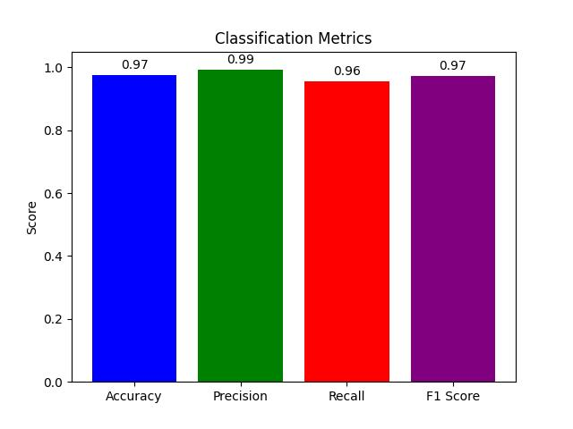
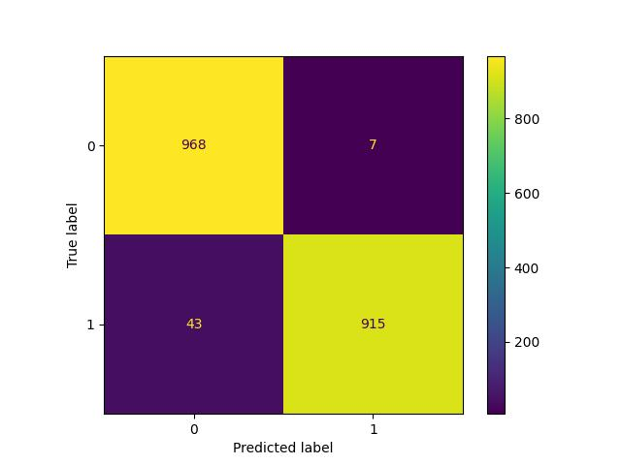
Performance achieved in English

Slide 11
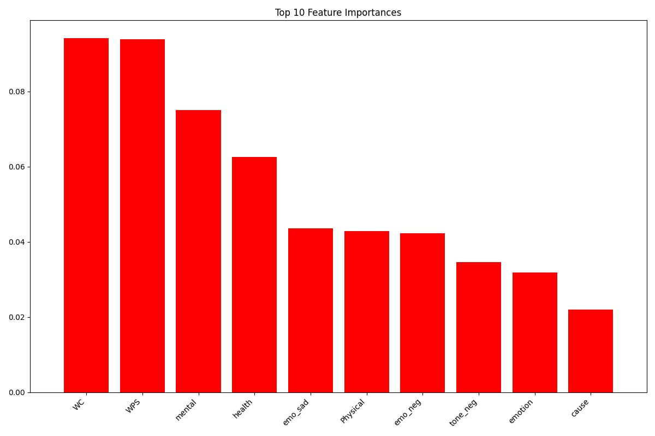
Performance achieved in English

Slide 12
Model for Romanian language
Dataset translated with Googletrans Python Library
LIWC-15 processing tool: 86 features
Random Forest Classifier
Classification Metrics, Confusion Matrix, Feature Importance

Slide 13
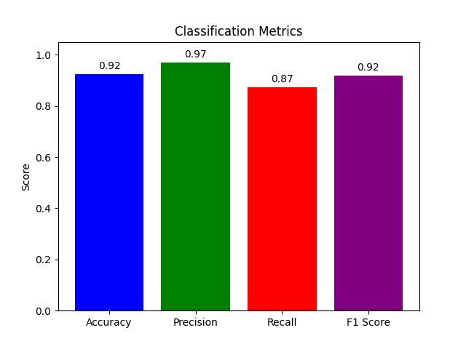
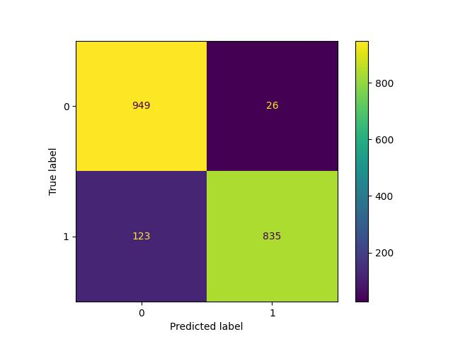
Performance achieved in Romanian

Slide 14
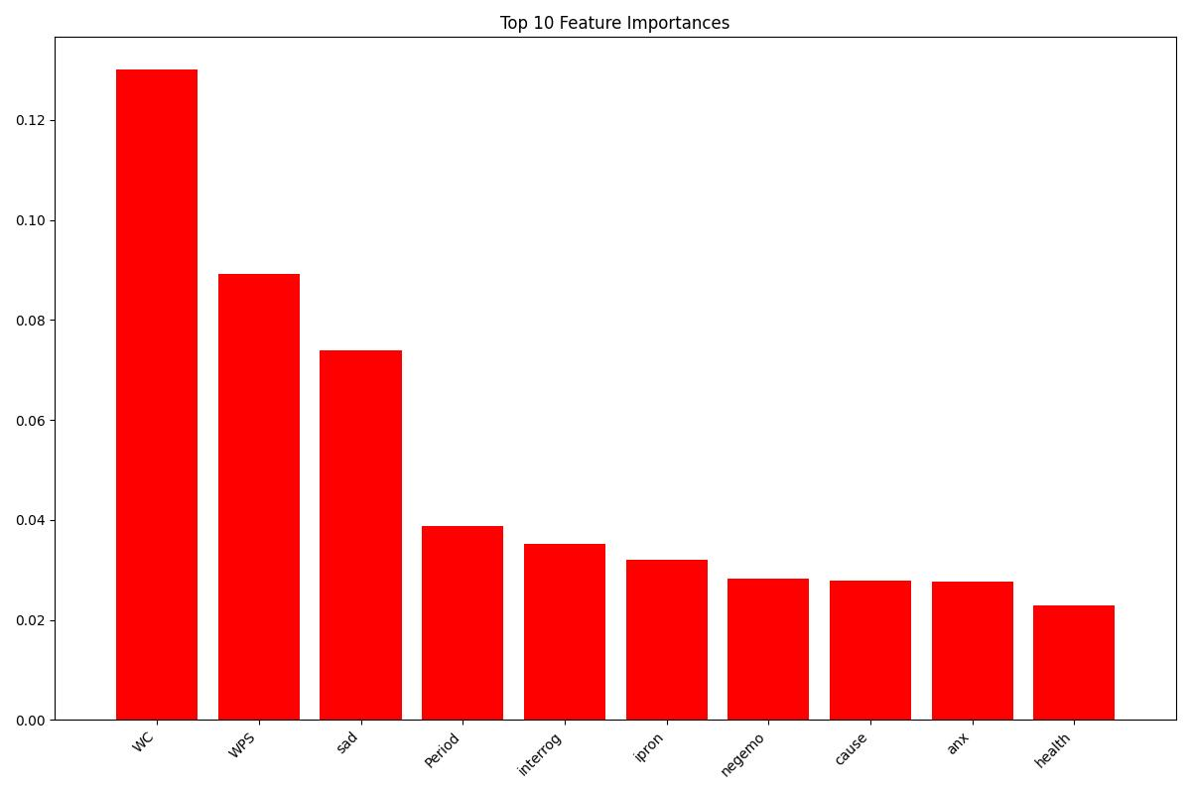
Performance achieved in Romanian

Slide 15
Weaknesses
Highly dependenant on input length
Problems in identifying positives
Poorer performance in Romanian due to decrease in LIWC version and machine translation method

Slide 16
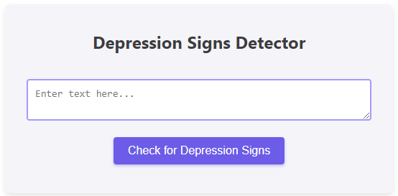
Chrome Extension for Detecting Depression
Easily accessible from where the user wants to analyze the possible text indicative of depression
Multiple languages supported

Slide 17
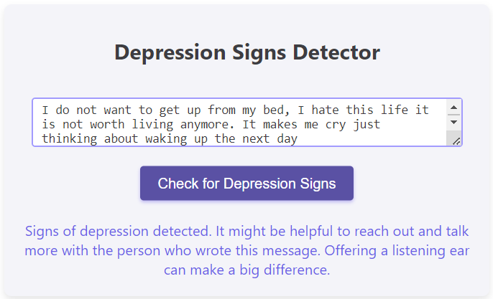
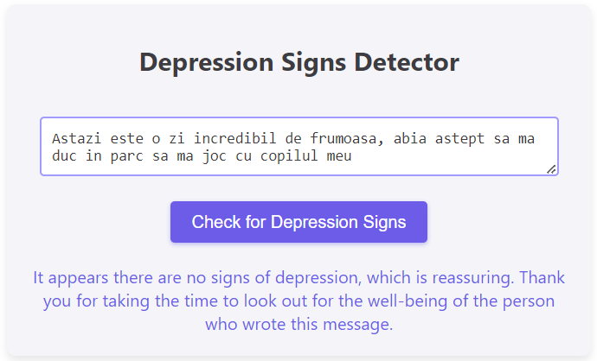
Output
Messages shown for depression or no depression found

Slide 18
Application Demo

Slide 19
Thank you for you attention!
Any questions?

